Slide 1
RDBMS Concepts

Slide 2
Data and Database
Data means information and it is the most important component in any work that is done.
A database is a collection of data.
Thus, a database is a collection of data that is organized such that its contents can be easily accessed, managed, and updated.
Stores Information
Database
Users
Allows to Access Information
Notes:
A database is a data structure that stores organized information. Most databases contain multiple tables, which may each include several different fields. For example, a company database may include tables for products, employees, and financial records. Each of these tables would have different fields that are relevant to the information stored in the table.

Slide 3
Data Management
Data management deals with managing large amount of information, which involves both the storage of information and the provision of mechanisms for the manipulation of information.
The two different approaches of managing data are:
File-based systems
Database systems

Slide 4
File Based Systems
An early attempt to computerize the manual filing system .
A collection of records or documents dealing with one organization, person, area or subject.
Example:
Manual (paper) files.
Computer files.

Slide 5
Problems with file storage
The process of manually maintaining data through files is :
Tedious
Time consuming
Error prone.
Notes:
Tedious: too long, slow, or dull

Slide 6
File-based systems
Disadvantages of File-based Systems are:
Data Redundancy and Inconsistency
Data Isolation
Concurrent Access Anomalies
Security Problems
Integrity(Reliability) Problems
Notes:
Redundancy: no longer needed or useful.
Unanticipated: not expected or predicted.
Isolation: apart from others
Concurrent Access Anomalies: irregularity happening, or done at the same time.
Enforcing data integrity ensures the quality of the data in the database. For example, if an employee is entered with an employee_id value of 123, the database should not allow another employee to have an ID with the same value.

Slide 7
Database Systems
Solved issues of handling large volume of data.
Used to store data in an efficient and organize manner.
Allows quick and easy management of data.
Data is more permanent and long-lasting.

Slide 8
Database Systems
Advantages of database systems:
The amount of redundancy in the stored data can be reduced.
No more inconsistent data.
The stored data can be shared.
Standard can be set and followed.
Data integrity can be maintained.
Security of data can be implemented.
Notes:
Redundancy: no longer needed or useful.
Enforcing data integrity ensures the quality of the data in the database. For example, If you have an employee_rating column intended to have values ranging from 1 to 5, the database should not accept a value of 6.

Slide 9
Database Management System (DBMS)
It is a collection of related records and a set of programs that access and manipulate these records.
DBMS provides an environment that is both convenient and efficient to use when there is a large volume of data and many transactions to be processed.
It enables the users to define, create, and maintain the database and provides controlled access to this database.
Notes:
A database management system (DBMS), sometimes just called a database manager, is a program that lets one or more computer users create and access data in a database.

Slide 10



Database Management System (DBMS)

Slide 11
Benefits of DBMS
The benefits of typical DBMS are as follows:
Data Storage
Data Definition
Data Manipulation
Data Security and Integrity
Data Recovery
Performance
Multi-user Access Control
Database Access Languages

Slide 12
Database Models
Databases can be differentiated based on functions and model of the data.
A data model describes a container for storing data, and the process of storing and retrieving data from that container.

Slide 13



Database Models
- Hierarchical model
- Network model
- Relational model

Slide 14
Hierarchical Model
A hierarchical data model is a database model in which the data is organized into a tree-like structure. The structure allows repeating information using parent/child relationships: each parent can have many children but each child only has one parent.

Slide 15
Network Model
The network model is a database model conceived as a easy and efficient way of representing objects and their relationships.
customer
Sales rep
product
invoice
payment
invline

Slide 16
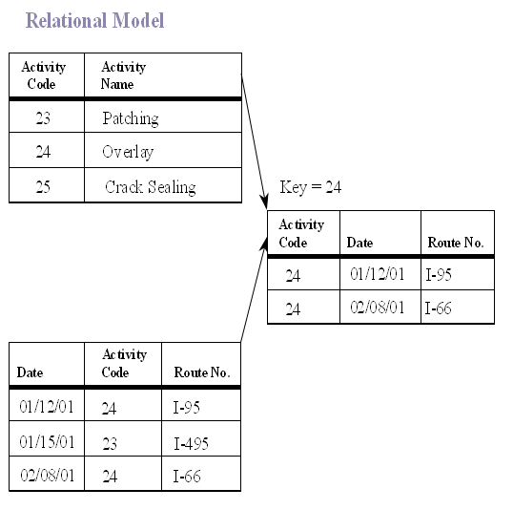
Relational Data Model
In the relational model, there is no physical link. All data is maintained in the form of tables consisting of rows and columns. Data in two tables is related through common columns.

Slide 17
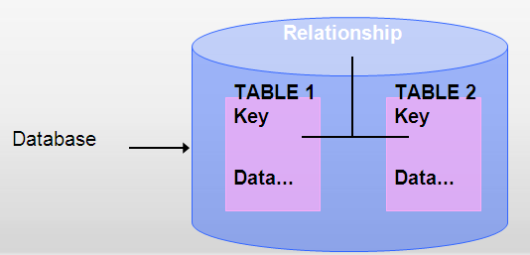
Relational Database Management System (RDBMS)
A Relational Database Management System (RDBMS) is a database management system where all data visible to the user is organized strictly as tables of data values, and where all database operations take place on these tables.
A relational database is a database divided into logical units called tables, where tables are related to one another within the database.

Slide 18
Terms related to RDBMS
These terms are mostly used in RDBMS:
Data is presented as a collection of relations.
Each relation is depicted as a table.
Columns are attributes.
Rows (“tuples”) represent entities.
Every table has a set of attributes that are taken together as a “key” (technically, a “superkey”), which uniquely identifies each entity.
Notes:
Depicted: represent by a drawing, painting, or other art form.

Slide 19
Terms related to RDBMS
Term | Meaning
Relation | A table
Tuple | A row or a record in a relation
Attribute | A field or a column in a relation
Cardinality of a relation | The number of tuples in a relation
Degree of a relation | The number of attributes in a relation
Domain of an attribute | The set of all values that can be taken by the attribute
Primary Key of a relation | An attribute or a combination of attributes that uniquely defines each tuple in a relation
Foreign Key | An attribute or a combination of attributes in one relation R1, which indicates the relationship of R1 with another relation R2 The foreign key attributes in R1 must contain values matching with those of the values in R2

Slide 20
Entities and Tables
An entity is a person, place, thing, object, event, or even a concept, which can be distinctly identified.
Each entity has certain characteristics known as attributes.
A table contains a group of related entities called an entity set.
The terms entity set and table are often used interchangeably. A table is also called a relation, rows are known as tuples and columns are known as attributes.

Slide 21
Entities and Tables
Table
Attributes
Emp_No | Emp_Name | Emp_DOB | Emp_DOJ
345 | James | 24-Sep-1968 | 30-May-1990
873 | Pamela | 27-Jul-1970 | 19-Nov-1993
693 | Allan | 10-Sep-1970 | 01-Jul-1992
305 | Geoff | 12-Feb-1973 | 29-Oct-1996
Tuples

Slide 22
Data Modeling
AND ER MODELS

Slide 23
Data Modeling
The analysis of data objects and their relationships to other data objects.
Data modeling is often the first step in creating a database
The designers first create a conceptual model of how data items relate to each other.
Data modeling involves a progression from conceptual model to logical model to physical model.

Slide 24
Levels of data modeling:
There three level of data modeling
conceptual data model
logical data model
physical data model

Slide 25
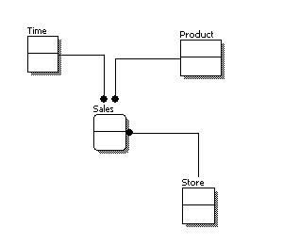
Conceptual Data Model
A conceptual data model identifies the highest-level relationships between the different entities.
No attribute is specified.
No primary key is specified.

Slide 26
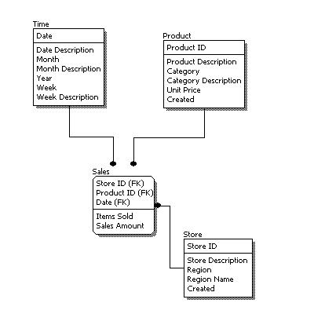
Logical Data Model
A logical data model describes the data in as much detail as possible, without regard to how they will be physical implemented in the database.
Identify entity and relationships.
All attributes of each entity.
Identify primary and foreign key.

Slide 27
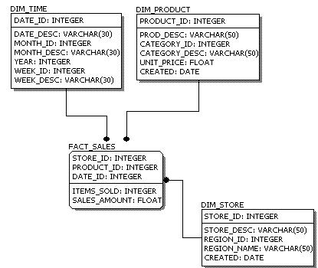
Physical Data Model
Physical data model represents how the model will be built in the database.

Slide 28
Comparison:
Feature | Conceptual | Logical | Physical
Entity Names | ✓ | ✓
Entity Relationships | ✓ | ✓
Attributes |  | ✓
Primary Keys |  | ✓ | ✓
Foreign Keys |  | ✓ | ✓
Table Names |  |  | ✓
Column Names |  |  | ✓
Column Data Types |  |  | ✓

Slide 29
Entity-Relationship Model
In software engineering, an entity-relationship model (ER Model) is an conceptual representation of data.
Entity-relationship modeling is a database modeling method, used to produce a type of conceptual schema of a system, often a relational database.
Diagrams created by this process are called entity-relationship diagrams, ER diagrams, or ERDs.

Slide 30
ER-Model
Three major elements in ER-Model
Entity
Attributes
Relationships

Slide 31
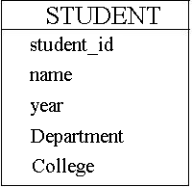
Entity:
A person, place or thing about which the data is collected.
For example: entity of “student”

Slide 32
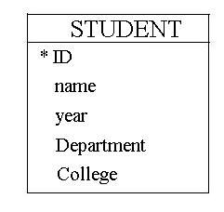
Attributes
Type of information that is captured related to the entity.
For the student entity, some related attributes include the
Student ID
Student Name
Which year of study
Which department the student
studies in?
5. College information

Slide 33
Relationship
A relationship is an association or bond that exists between one or more entities.
For example :
Belongs to, own, works for, saves in, purchases and so on

Slide 34
Relationship
There are three types of relationships between tables. The type of relationship that is created depends on how the related columns are defined.
One-to-Many Relationship
Many-to-Many Relationships
One-to-One Relationships
Many-to-One Relationships

Slide 35
One-to-Many Relationships
A one-to-many relationship is the most common type of relationship. In this type of relationship, a row in table A can have many matching rows in table B, but a row in table B can have only one matching row in table A.
For example, the PUBLISHERS and BOOKS tables have a one-to-many relationship: each publisher produces many titles, but each title comes from only one publisher.

Slide 36
One-to-Many Relationships
BOOKS
PUBLISHER

Slide 37
Many-to-Many Relationships
In a many-to-many relationship, a row in table A can have many matching rows in table B, and vice versa.
For example, the AUTHORS table and the BOOKS table have a many-to-many relationship that is defined by a one-to-many relationship from each of these tables.

Slide 38
Many-to-Many Relationships
BOOKS
AUTHORS

Slide 39
One-to-One Relationships
In a one-to-one relationship, a row in table A can have no more than one matching row in table B, and vice versa. A one-to-one relationship is created if both of the related columns are primary keys or have unique constraints.
This type of relationship is not common because most information related in this way would be all in one table.
PERSON
LOCATION

Slide 40
Many-to-One Relationships
In a many-to-one relationship, one or more row in table A can have no more than one matching row in table B.
For example, many vehicle are manufactured by one manufacturer.
VEHICLE
MANUFACTURER

Slide 41
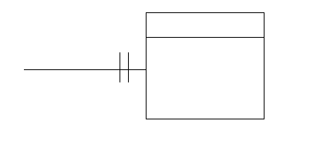
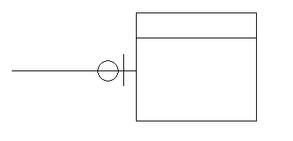
ER-Model
Relationship:
Exactly one relationship (1)
Zero or 1 relationship
(0/1)

Slide 42
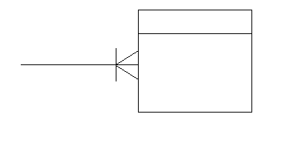
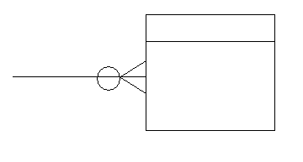
ER-Model
One or more relationship ( >= 1)
Zero or more relationship ( >= 0)

Slide 43
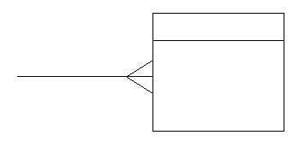
ER-Model
More than one (>1)

Slide 44
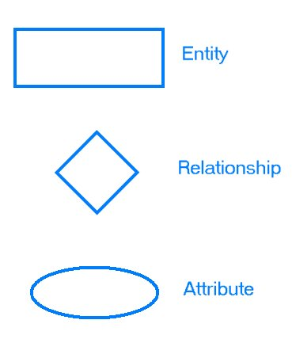
Steps to create ER model:
Gather Data.
Identify entities
Identify the attributes.
Identify relations.
Draw diagram using
symbols.

Slide 45
ERD Example:
street
city
ZIP
Customer_address
Account_owner
customer_contact
Account_number
Customer_name
balance
Saves in
Customer
Account

Slide 46
Normalization

Slide 47
Normalization
Normalization is the process of efficiently organizing data in a database.
Normalization is the process of applying a series of rules to ensure that your database achieves optimal structure.

Slide 48
Why we do Normalization?
There are two goals of the normalization process:
1- eliminating redundant data
For example: storing the same data in more than
one table
2- ensuring data dependencies make sense.
For example: only storing related data in a table.
Both of these are worthy goals as they reduce the amount of space a database consumes and ensure that data is logically stored.

Slide 49
Database Anomalies:
Repetition Anomaly
Insertion Anomaly
Deletion Anomaly
Updating Anomaly

Slide 50
First Normal Form (1NF)
Each attribute must be atomic
No repeating columns within a row.
No multi-valued columns.
1NF simplifies attributes
Queries become easier.

Slide 51
1NF
Employee (unnormalized)
Employee (1NF)

Slide 52
Second Normal Form (2NF)
Each attribute must be functionally dependent on the primary key.
Partial Functional dependency – a non-key attribute should not be partially(functionally) dependent on more than one key attribute.
Any non-dependent attributes are moved into a smaller (subset) table.
2NF improves data integrity.
Prevents update, insert, and delete anomalies.

Slide 53
Functional Dependency
Employee (1NF)
Emp_name, grade and salary are functionally dependent only on emp_no. (emp_no -> emp_name, grade, salary)
Project_name is dependent only on project_id.
But these table should be related through foreign keys.

Slide 54

2NF
Employee (2NF)
Project (2NF)

Slide 55
Data Integrity
Insert Anomaly - adding null values. eg, inserting a new project does not require the primary key of emp_no to be added.
Update Anomaly - multiple updates for a single name change, causes performance degradation. eg, changing magnum project_name to meganum.
Delete Anomaly - deleting wanted information. eg, deleting the magnum project removes employee John personal info from the database.

Slide 56
Third Normal Form (3NF)
Remove transitive dependencies.
Transitive dependency – if an attribute can be determined by another non-key attribute.
Any transitive dependencies are moved into a smaller (subset) table.
3NF further improves data integrity.
Prevents update, insert, and delete anomalies.

Slide 57
Transitive Dependency
Employee (3NF)
salary is determined by grade and not the key attribute emp_no.
Thus this transitive dependency needs to be removed, and grade and salary are moved to another table.
Notes:
Note, dept_name is functionally dependent on dept_no. Dept_no is functionally dependent on emp_no, so via the middle step of dept_no, dept_name is functionally dependent on emp_no.
(emp_no -> dept_no , dept_no -> dept_name, thus emp_no -> dept_name)

Slide 58
3NF
Employee (3NF)
Grade Salary(3NF)
Employee Project(3NF)
Project (3NF)

Slide 59
SQL STATEMENTS

Slide 60
Here is an example of a simple database table:
Table: Customers
FirstName | LastName | Email | DOB | Phone
John | Smith | John.Smith@yahoo.com | 2/4/1968 | 626 222-2222
Steven | Goldfish | goldfish@fishhere.net | 4/4/1974 | 323 455-4545
Paula | Brown | pb@herowndomain.org | 5/24/1978 | 416 323-3232
James | Smith | jim@supergig.co.uk | 20/10/1980 | 416 323-8888

Slide 61
Primary Key (PK)
A primary key is a table column that can be used to uniquely identify every row of the table.
Any column that has this property will do -- these columns are called candidate keys.
A table can have many candidate keys but only one primary key. The primary key cannot be null.

Slide 62
ForeignKey
A foreign key is a column, or combination of columns, that contain values that are found in the primary key
of some table (including, possibly, itself).
A foreign key may be null, and almost always is not unique.
ClrPK | ColourName
10 | yellow
20 | red
30 | green
40 | blue
AdjPK | AdjectiveName | ClrFK
904 | angry | 20
913 | envious | 30
937 | lazy | 40
941 | lonely | 40
954 | fearful | 10
979 | jealous | 30
991 | furious | 50

Slide 63
Language statements:
The basic structure in SQL is the statement. Semicolons separate multiple SQL statements.
SQL is not case sensitive
Data Manipulation language(DML)
Data Definition language(DDL)
Data Control Language(DCL)

Slide 64
1.Data definition language

Slide 65
Database ddl actions:
DDL actions are used to define and manage database objects.
Following are the DDL actions:
Create database/table
Alter table
Drop database/table

Slide 66
1.The CREATE DATABASE Statement
The CREATE DATABASE statement is used to create a database.
CREATE DATABASE database_name

Slide 67
2.CREATE TABLE
The CREATE TABLE statement is used to create a table in a existing database.
CREATE TABLE table_name ( column_name1 data_type, column_name2 data_type, column_name3 data_type, .... )

Slide 68
Example:
CREATE TABLE customer ( C_Id int, LastName varchar(255), FirstName varchar(255), Address varchar(255), City varchar(255) )

Slide 69
3.Alter Table:
The ALTER TABLE statement is used to add, delete, or modify columns in an existing table.

Slide 70
SYNTAX
1.To delete a column in a table:
ALTER TABLE table name DROP COLUMN column name
2.To change the data type of a column in a table:
ALTER TABLE table_name ALTER COLUMN column_name datatype
3.To add a column in a table:
ALTER TABLE table_name ADD column_name datatype

Slide 71
Drop Command in SQL:
Drop command is used to remove an Object from a database or used to remove complete database.
When Drop Table command is used, it deletes all rows from that table, then removes the table from the database and removes all references to that table.
Syntax:
DROP TABLE Table_Name Ex: DROP TABLE Department

Slide 72
Truncate Command in SQL:
Truncate Command is used to delete all the records from a table and frees the space in disc. Syntax: TRUNCATE TABLE Table_Name Ex: TRUNCATE TABLE Department

Slide 73
Difference between Delete and Truncate Command:
Delete Command deletes records from a table based on a condition or deletes all the records if no condition is specified. But it doesn't free the space.
Truncate Command deletes all the records from a table as well as frees up the space.

Slide 74
Difference between Drop and Truncate Command in SQL:
Truncate Command removes all rows from a table, but the table structure, all relationships, constraints remain in the Database.
Drop Command removes the entire table, all relationships associated with that table, all constraints in that table.
We can insert new records in a truncated table. But it is not possible when a table is dropped as it doesn't exist.

Slide 75
SQL(DML)
Notes:
Frequently, presenters must deliver material of a technical nature to an audience unfamiliar with the topic or vocabulary. The material may be complex or heavy with detail. To present technical material effectively, use the following guidelines from Dale Carnegie Training®.
Consider the amount of time available and prepare to organize your material. Narrow your topic. Divide your presentation into clear segments. Follow a logical progression. Maintain your focus throughout. Close the presentation with a summary, repetition of the key steps, or a logical conclusion.
Keep your audience in mind at all times. For example, be sure data is clear and information is relevant. Keep the level of detail and vocabulary appropriate for the audience. Use visuals to support key points or steps. Keep alert to the needs of your listeners, and you will have a more receptive audience.

Slide 76
DML INTRODUCTION
DML stands for Data manipulation language.
DML are used for managing data in database.
or
DML statements are used to work with the data in tables

Slide 77
DML statements
These are the following DML statements:
INSERT
UPDATE
DELETE
SELECT
TRUNCATE

Slide 78
Data Manipulation Language (DML)
Used to create, modify and retrieve data
Insert
Select
Update
Delete
to insert data into a table
to query data in the database
to update data in a table
to delete data from a table

Slide 79
DML - Adding Data to a Table
Insert statement is used to insert data into a table.
Use the Insert keyword and specify:
table name
field names - optional
values for each field
SYNTAX:
INSERT into table-name values(data1,data2,..)
Notes:
INSERT INTO Department
VALUES (1,'Electronics',1);
INSERT INTO Student
VALUES ('1234', 'Muhammad', 'Ali',1);

Slide 80
DML - Adding Data to a Table
EXAMPLE:
Output:
INSERT into batch1706 values(101,'Ahsan',’karachi’,’tahir’,’nadia’)
S_id | SName | address | lastname | mothername
101 Ahsan Karachi tahir nadia
Notes:
INSERT INTO Department
VALUES (1,'Electronics',1);
INSERT INTO Student
VALUES ('1234', 'Muhammad', 'Ali',1);

Slide 81
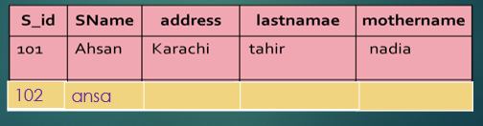
DML - Adding Data to a Table
SYNTAX:
EXAMPLE:
INSERT INTO TableName [(columnList)] VALUES (dataValueList)
INSERT into batch1706(Id, name) values(102,'Ansa')
Notes:
INSERT INTO Department
VALUES (1,'Electronics',1);
INSERT INTO Student
VALUES ('1234', 'Muhammad', 'Ali',1);

Slide 82
DML - Adding Data to a Table
EXAMPLE:
Output:
insert into batch1706 values (34,‘nida',’lahore123’,’zeeshan’,’sidra’),(14,'hamza',’karachi’,’taimoor’,’rida’)
S_ID | SName | address | lastname | mothername
101 | ahsan | karachi | tahir | nadia
102 | ansa
34 | nida | lahore23 | zeeshan | sidra
14 | hamza | karachi | taimoor | rida
Notes:
INSERT INTO Department
VALUES (1,'Electronics',1);
INSERT INTO Student
VALUES ('1234', 'Muhammad', 'Ali',1);

Slide 83
DML SELECT Statement
Select query is used to retrieve data from a tables. It is the most used SQL query.
We can retrieve complete tables, or partial by mentioning conditions using WHERE clause
SYNTAX:
SELECT column-name1, column-name2,column-nameN from table-name;

Slide 84
DML SELECT Statement
EXAMPLE:
Output:
SELECT * from batch1706
S_ID | SName | address | lastname | mothername
101 | ahsan | karachi | tahir | nadia
102 | ansa
34 | nida | lahore23 | zeeshan | sidra
14 | hamza | karachi | taimoor | rida

Slide 85
DML SELECT Statement
EXAMPLE:
Output:
SELECT * from batch1706 WHERE sname = 'Ahsan';
S_ID | SName | address | lastname | mothername
101 | ahsan | karachi | tahir | nadia

Slide 86
DML :LIKE clause
EXAMPLE:
The above query will return all records where sname starts with character 'A'.
Output:
SELECT * from batch1706 where sname like 'A%'
S_ID | SName | address | lastname | mothername
101 | ahsan | karachi | tahir | nadia
102 | ansa | null | null | null

Slide 87
DML :LIKE clause
EXAMPLE:
The above query will return all records from Student table where sname contain ‘a' as second character.
Output:
SELECT * from batch1706 where sname like '_a%'
S_ID | SName | address | lastname | mothername
14 | hamza | karachi | taimoor | rida

Slide 88
DML :LIKE clause
EXAMPLE:
The above query will return all records from Student table where sname contain ‘a' as last character.
Output:
SELECT * from batch1706 where sname like '%a'
S_ID | SName | address | lastname | mothername
102 | ansa
34 | nida | lahore23 | zeeshan | sidra
14 | hamza | karachi | taimoor | rida

Slide 89
DML - Updating Data in a Table
Update command is used to modifies data of one or more records..
Use the Update and Set keywords and specify:
table name
field name(s)
where clause
SYNTAX:
UPDATE table-name set column-name = value where condition

Slide 90
DML - Updating Data in a Table
EXAMPLE
Ouput:
update batch1706 set address=‘Islamabad’ wheres_id=102
S_ID | SName | address | lastname | mothername
101 | ahsan | karachi | tahir | nadia
102 | ansa | islamabad
34 | nida | lahore23 | zeeshan | sidra
14 | hamza | karachi | taimoor | rida

Slide 91
DML - Updating Data in a Table
EXAMPLE
Ouput:
UPDATE batch1706 set sname=‘tariq', lastname=‘shariq’ where s_id=14
S_ID | SName | address | lastname | mothername
101 | ahsan | karachi | tahir | nadia
102 | ansa
34 | nida | lahore23 | zeeshan | sidra
14 | tariq | karachi | shariq | rida

Slide 92
DML-Deleting Records
Delete command is used to remove data from a table.
Delete command can also be used with condition to delete
a particular row.
SYNTAX:
Example:
Output:
DELETE from table-name
delete from batch1706 where sname=‘ahsan‘
S_ID | SName | address | lastname | mothername
102 | ansa
34 | nida | lahore23 | zeeshan | sidra
14 | tariq | karachi | shariq | rida

Slide 93
DML-Deleting Records
Delete command is used to remove data from a table.
Delete command can also be used with condition to delete
a particular row.
Use the Delete From keywords and specify:
table name
where clause (optional)
EXAMPLE:
Output:
DELETE from batch1706
S_id | SName | address | lastname | mothername

Slide 94
DML-Truncate
The SQL TRUNCATE TABLE command is used to delete complete data from an existing table
SYNTAX:
EXAMPLE:
TRUNCATE TABLE table name
TRUNCATE TABLE batch1706

Slide 95
SQL STATEMENTS

Slide 96
1.Selecting Data
The select statement is used to query the database and retrieve selected data that match the criteria that you specify. Here is the format of a simple select statement:
SELECT * FROM Table1
The column names that follow the select keyword determine which columns will be returned in the results. You can select as many column names that you'd like, or you can use a "*" to select all columns.
SELECT Column1, Column2, Column3,
FROM Table1
The table name that follows the keyword from specifies the table that will be queried to retrieve the desired results.

Slide 97
SQL DISTINCT
The SQL DISTINCT clause is used together with the SQL SELECT keyword, to return a dataset with unique entries for certain database table column.
SQL SELECT DISTINCT is a very useful way to eliminate retrieving duplicate data reserved for very specific situations.

Slide 98
We will use our Customers database table to illustrate the usage of SQL DISTINCT.
FirstName | LastName | Email | DOB | Phone
John | Smith | John.Smith@yahoo.com | 2/4/1968 | 626 222-2222
Steven | Goldfish | goldfish@fishhere.net | 4/4/1974 | 323 455-4545
Paula | Brown | pb@herowndomain.org | 5/24/1978 | 416 323-3232
James | Smith | jim@supergig.co.uk | 20/10/1980 | 416 323-8888
SELECT DISTINCT LastName FROM Customers
LastName
Smith
Goldfish
Brown

Slide 99
CONSTRAINTS
SQL constraints are used to specify rules for data in a table.
Constraints can be specified when the table is created with the CREATE TABLE statement, or after the table is created with the ALTER TABLE statement.

Slide 100
Syntax
CREATE TABLE table_name ( column1 datatype constraint, column2 datatype constraint, column3 datatype constraint, .... );

Slide 101
constraints
The following constraints are commonly used in SQL:
NOT NULL - Ensures that a column cannot have a NULL value
UNIQUE - Ensures that all values in a column are different
PRIMARY KEY - A combination of a NOT NULL and UNIQUE. Uniquely identifies each row in a table
FOREIGN KEY - Uniquely identifies a row/record in another table
CHECK - Ensures that all values in a column satisfies a specific condition
DEFAULT - Sets a default value for a column when no value is specified

Slide 102
NOT NULL Constraint
By default, a column can hold NULL values.
The NOT NULL constraint enforces a column to NOT accept NULL values.
This enforces a field to always contain a value, which means that you cannot insert a new record, or update a record without adding a value to this field.

Slide 103
example
CREATE TABLE Persons ( ID int NOT NULL, LastName varchar(255) NOT NULL, FirstName varchar(255) NOT NULL, Age int );

Slide 104
UNIQUE Constraint
The UNIQUE constraint ensures that all values in a column are different.
Both the UNIQUE and PRIMARY KEY constraints provide a guarantee for uniqueness for a column or set of columns.
A PRIMARY KEY constraint automatically has a UNIQUE constraint.
However, you can have many UNIQUE constraints per table, but only one PRIMARY KEY constraint per table.

Slide 105
example
CREATE TABLE Persons ( ID int NOT NULL UNIQUE, LastName varchar(255) NOT NULL, FirstName varchar(255), Age int );

Slide 106
PRIMARY KEY Constraint
The PRIMARY KEY constraint uniquely identifies each record in a database table.
Primary keys must contain UNIQUE values, and cannot contain NULL values.
A table can have only one primary key, which may consist of single or multiple fields.

Slide 107
example
CREATE TABLE Persons ( ID int NOT NULL, LastName varchar(255) NOT NULL, FirstName varchar(255), Age int, PRIMARY KEY (ID) );

Slide 108
FOREIGN KEY Constraint
A FOREIGN KEY is a key used to link two tables together.
A FOREIGN KEY is a field (or collection of fields) in one table that refers to the PRIMARY KEY in another table.
The table containing the foreign key is called the child table, and the table containing the candidate key is called the referenced or parent table.

Slide 109
example
CREATE TABLE Orders ( OrderID int NOT NULL, OrderNumber int NOT NULL, PersonID int, PRIMARY KEY (OrderID), FOREIGN KEY (PersonID) REFERENCES Persons(PersonID) );

Slide 110
CHECK Constraint
The CHECK constraint is used to limit the value range that can be placed in a column.
If you define a CHECK constraint on a single column it allows only certain values for this column.
If you define a CHECK constraint on a table it can limit the values in certain columns based on values in other columns in the row.

Slide 111
example
CREATE TABLE Persons ( ID int NOT NULL, LastName varchar(255) NOT NULL, FirstName varchar(255), Age int, CHECK (Age>=18) );

Slide 112
DEFAULT Constraint
The DEFAULT constraint is used to provide a default value for a column.
The default value will be added to all new records IF no other value is specified.

Slide 113
example
CREATE TABLE Persons ( ID int NOT NULL, LastName varchar(255) NOT NULL, FirstName varchar(255), Age int, City varchar(255) DEFAULT 'Sandnes' );

Slide 114
WHERE clause
The SQL WHERE clause is used to select data conditionally, by adding it to already existing SQL SELECT query.
The where clause (optional) specifies which data values or rows will be returned or displayed, based on the criteria described after the keyword where.
Conditional selections used in the where clause:
WHERE clause is used to filter out rows and only selecting data that meets the conditional statement.

Slide 115
we can use any of the following operators in conjunction with the SQL WHERE clause:
Operator | Description
= | Equal
<> | Not equal
> | Greater than
< | Less than
>= | Greater than or equal
<= | Less than or equal
BETWEEN | Between an inclusive range
LIKE | Search for a pattern
IN | If you know the exact value you want to return for at least one of the columns

Slide 116
SQL - Where with Multiple Conditions
A WHERE statement can accept multiple conditional statements. What this means is that we are able to select rows meeting two different conditions at the same time.
The AND & OR operators are used to filter records based on more than one condition.

Slide 117
WHERE clause with AND operator
The SQL AND clause is used when you want to specify more than one condition in your SQL WHERE clause, and at the same time you want all conditions to be true.

Slide 118
Customers
FirstName | LastName | Email | DOB | Phone
John | Smith | John.Smith@yahoo.com | 2/4/1968 | 626 222-2222
Steven | Goldfish | goldfish@fishhere.net | 4/4/1974 | 323 455-4545
Paula | Brown | pb@herowndomain.org | 5/24/1978 | 416 323-3232
James | Smith | jim@supergig.co.uk | 20/10/1980 | 416 323-8888
SELECT * FROM Customers WHERE FirstName = 'John' AND LastName = 'Smith'
FirstName | LastName | Email | DOB | Phone
John | Smith | John.Smith@yahoo.com | 2/4/1968 | 626 222-2222

Slide 119
WHERE clause with OR operator
The SQL OR clause will return all rows satisfying any of the conditions listed in the WHERE clause.

Slide 120
Customers
FirstName | LastName | Email | DOB | Phone
John | Smith | John.Smith@yahoo.com | 2/4/1968 | 626 222-2222
Steven | Goldfish | goldfish@fishhere.net | 4/4/1974 | 323 455-4545
Paula | Brown | pb@herowndomain.org | 5/24/1978 | 416 323-3232
James | Smith | jim@supergig.co.uk | 20/10/1980 | 416 323-8888
SELECT * FROM Customers WHERE FirstName = 'James' OR FirstName = 'Paula'
FirstName | LastName | Email | DOB | Phone
Paula | Brown | pb@herowndomain.org | 5/24/1978 | 416 323-3232
James | Smith | jim@supergig.co.uk | 20/10/1980 | 416 323-8888

Slide 121
Combine AND & OR :
You can combine AND and OR clauses anyway you want and you can use parentheses to define your logical expressions.

Slide 122
Customers
FirstName | LastName | Email | DOB | Phone
John | Smith | John.Smith@yahoo.com | 2/4/1968 | 626 222-2222
Steven | Goldfish | goldfish@fishhere.net | 4/4/1974 | 323 455-4545
Paula | Brown | pb@herowndomain.org | 5/24/1978 | 416 323-3232
James | Brown | jim@supergig.co.uk | 20/10/1980 | 416 323-8888
SELECT * FROM Customers WHERE (FirstName = 'James' OR FirstName = 'Paula') AND LastName = 'Brown'
FirstName | LastName | Email | DOB | Phone
Paula | Brown | pb@herowndomain.org | 5/24/1978 | 416 323-3232

Slide 123
ORDER BY clause
ORDER BY is the SQL command used to sort rows as they are returned from a SELECT query.
The ORDER BY keyword sort the records in ascending order by default.
If you want to sort the records in a descending order, you can use the DESC keyword.
SQL ORDER BY Syntax
SELECT column_name(s) FROM table_name ORDER BY column_name(s) ASC|DESC

Slide 124
Customers
FirstName | LastName | Email | DOB | Phone
John | Smith | John.Smith@yahoo.com | 2/4/1968 | 626 222-2222
Steven | Goldfish | goldfish@fishhere.net | 5/24/1978 | 323 455-4545
Paula | Brown | pb@herowndomain.org | 4/4/1974 | 416 323-3232
James | Smith | jim@supergig.co.uk | 20/10/1980 | 416 323-8888
SELECT * FROM Customers ORDER BY DOB
FirstName | LastName | Email | DOB | Phone
John | Smith | John.Smith@yahoo.com | 2/4/1968 | 626 222-2222
Steven | Goldfish | goldfish@fishhere.net | 4/4/1974 | 323 455-4545
Paula | Brown | pb@herowndomain.org | 5/24/1978 | 416 323-3232
James | Smith | jim@supergig.co.uk | 20/10/1980 | 416 323-8888

Slide 125
SELECT * FROM Customers ORDER BY DOB DESC
FirstName | LastName | Email | DOB | Phone
James | Smith | jim@supergig.co.uk | 20/10/1980 | 416 323-8888
Paula | Brown | pb@herowndomain.org | 5/24/1978 | 416 323-3232
Steven | Goldfish | goldfish@fishhere.net | 4/4/1974 | 323 455-4545
John | Smith | John.Smith@yahoo.com | 2/4/1968 | 626 222-2222

Slide 126
IN Operator
SQL IN is an operator used to pull data matching a list of values.
A scenario where this proves useful would be if we wanted to retrieve customer data for two or more customers. We can use the IN operator to specify a list of customer names, and SQL will retrieve rows reflecting every customer in the list.

Slide 127
THE SQL IN syntax looks like this:
THE SQL NOT IN syntax looks like this:
SELECT Column1, Column2, Column3, … FROM Table1 WHERE Column1 IN (Valu1, Value2, …)
SELECT Column1, Column2, Column3, … FROM Table1 WHERE Column1 NOT IN (Valu1, Value2, …)

Slide 128
EmployeeHours table
Employee | Date | Hours
John Smith | 5/6/2004 | 8
Allan Babel | 5/6/2004 | 8
Tina Crown | 5/6/2004 | 8
John Smith | 5/7/2004 | 9
Allan Babel | 5/7/2004 | 8
Tina Crown | 5/7/2004 | 10
John Smith | 5/8/2004 | 8
Allan Babel | 5/8/2004 | 8
Tina Crown | 5/8/2004 | 9
SELECT * FROM EmployeeHours WHERE Hours IN (9, 10)
Employee | Date | Hours
John Smith | 5/7/2004 | 9
Tina Crown | 5/7/2004 | 10
Tina Crown | 5/8/2004 | 9

Slide 129
LIKE operator
The SQL LIKE clause is very useful when you want to specify a search condition within your SQL WHERE clause, for a specified pattern in a column.
SELECT column_name(s) FROM table_name WHERE column_name LIKE pattern

Slide 130
SQL wildcards must be used with the SQL LIKE operator.
With SQL, the following wildcards can be used:
Wildcard | Description
% | A substitute for zero or more characters
_ | A substitute for exactly one character
[charlist] | Any single character in charlist
[^charlist]or [!charlist] | Any single character not in charlist

Slide 131
Customers table
FirstName | LastName | Email | DOB | Phone
John | Smith | John.Smith@yahoo.com | 2/4/1968 | 626 222-2222
Steven | Goldfish | goldfish@fishhere.net | 4/4/1974 | 323 455-4545
Paula | Brown | pb@herowndomain.org | 5/24/1978 | 416 323-3232
James | Smith | jim@supergig.co.uk | 20/10/1980 | 416 323-8888
SELECT * FROM Customers WHERE FirstName LIKE ‘_a%'
FirstName | LastName | Email | DOB | Phone
John | Smith | John.Smith@yahoo.com | 2/4/1968 | 626 222-2222
James | Smith | jim@supergig.co.uk | 20/10/1980 | 416 323-8888

Slide 132
Sample Table: empinfo
first | last | id | age | city | state
John | Jones | 99980 | 45 | Payson | Arizona
Mary | Jones | 99982 | 25 | Payson | Arizona
Eric | Edwards | 88232 | 32 | San Diego | California
Mary Ann | Edwards | 88233 | 32 | Phoenix | Arizona
Ginger | Howell | 98002 | 42 | Cottonwood | Arizona
Sebastian | Smith | 92001 | 23 | Gila Bend | Arizona
Gus | Gray | 22322 | 35 | Bagdad | Arizona
Mary Ann | May | 32326 | 52 | Tucson | Arizona
Erica | Williams | 32327 | 60 | Show Low | Arizona
Leroy | Brown | 32380 | 22 | Pinetop | Arizona
Elroy | Cleaver | 32382 | 22 | Globe | Arizona
select first, last, from empinfo where last LIKE '%s';
first | last
John | Jones
Mary | Jones
Eric | Edwards
Mary Ann | Edwards
Erica | Williams

Slide 133
select first, last, age from empinfo where last LIKE '%illia%';
Sample Table: empinfo
first | last | id | age | city | state
John | Jones | 99980 | 45 | Payson | Arizona
Mary Ann | Edwards | 88233 | 32 | Phoenix | Arizona
Sebastian | Smith | 92001 | 23 | Gila Bend | Arizona
Mary Ann | May | 32326 | 52 | Tucson | Arizona
Erica | Williams | 32327 | 60 | Show Low | Arizona
Leroy | Brown | 32380 | 22 | Pinetop | Arizona
first | last | age
Erica | Williams | 60

Slide 134
Persons table
P_Id | LastName | FirstName | Address | City
1 | Hansen | Ola | Timoteivn 10 | Sandnes
2 | Svendson | Tove | Borgvn 23 | Sandnes
3 | Pettersen | Kari | Storgt 20 | Stavanger
SELECT * FROM Persons WHERE FirstName LIKE '_la'
P_Id | LastName | FirstName | Address | City
1 | Hansen | Ola | Timoteivn 10 | Sandnes

Slide 135
Persons table
P_Id | LastName | FirstName | Address | City
1 | Hansen | Ola | Timoteivn 10 | Sandnes
2 | Svendson | Tove | Borgvn 23 | Sandnes
3 | Pettersen | Kari | Storgt 20 | Stavanger
SELECT * FROM Persons WHERE LastName LIKE '[bsp]%'
P_Id | LastName | FirstName | Address | City
2 | Svendson | Tove | Borgvn 23 | Sandnes
3 | Pettersen | Kari | Storgt 20 | Stavanger
SELECT * FROM Persons WHERE LastName LIKE '[^bsp]%'
P_Id | LastName | FirstName | Address | City
1 | Hansen | Ola | Timoteivn 10 | Sandnes

Slide 136
SELECT * FROM Customers WHERE Phone LIKE '[4-6]_6%'
This SQL expression will return all customers satisfying the following conditions:
The Phone column starts with a digit between 4 and 6 ([4-6])
Second character in the Phone column can be anything (_)
The third character in the Phone column is 6 (6)
The remainder of the Phone column can be any character string (%)
FirstName | LastName | Email | DOB | Phone
John | Smith | John.Smith@yahoo.com | 2/4/1968 | 626 222-2222
Steven | Goldfish | goldfish@fishhere.net | 4/4/1974 | 323 455-4545
Paula | Brown | pb@herowndomain.org | 5/24/1978 | 416 323-3232
James | Smith | jim@supergig.co.uk | 20/10/1980 | 416 323-8888

Slide 137
OUTPUT
FirstName | LastName | Email | DOB | Phone
John | Smith | John.Smith@yahoo.com | 2/4/1968 | 626 222-2222
Paula | Brown | pb@herowndomain.org | 5/24/1978 | 416 323-3232
James | Smith | jim@supergig.co.uk | 20/10/1980 | 416 323-8888

Slide 138
The TOP Clause
The TOP clause is used to specify the number of records to return.
SQL Server Syntax
SELECT TOP number|percent column_name(s) FROM table_name

Slide 139
SQL FUNCTIONS

Slide 140
SQL Aggregate Functions
SQL aggregate functions return a single value, calculated from values in a column.
Useful aggregate functions:
AVG() - Returns the average value
COUNT() - Returns the number of rows
MAX() - Returns the largest value
MIN() - Returns the smallest value
SUM() - Returns the sum

Slide 141
1.SQL COUNT()
The SQL COUNT aggregate function is used to count the number of rows in a database table.
SELECT COUNT(*)
FROM table_name
SELECT COUNT(Column1) FROM Table1
SELECT COUNT(DISTINCT column_name) FROM table_name

Slide 142
If we want to count the number of customers in our Customers table, we will use the following SQL COUNT statement:
SELECT COUNT(LastName) AS NumberOfCustomers FROM Customers
FirstName | LastName | Email | DOB | Phone
John | Smith | John.Smith@yahoo.com | 2/4/1968 | 626 222-2222
Steven | Goldfish | goldfish@fishhere.net | 4/4/1974 | 323 455-4545
Paula | Brown | pb@herowndomain.org | 5/24/1978 | 416 323-3232
James | Smith | jim@supergig.co.uk | 20/10/1980 | 416 323-8888
NumberOfCustomers
4

Slide 143
2.SQL AVG():
The SQL AVG aggregate function selects the average value for certain table column.
SELECT AVG(Column1) FROM Table1

Slide 144
Orders table
O_Id | OrderDate | OrderPrice | Customer
1 | 2008/11/12 | 1000 | Hansen
2 | 2008/10/23 | 1600 | Nilsen
3 | 2008/09/02 | 700 | Hansen
4 | 2008/09/03 | 300 | Hansen
5 | 2008/08/30 | 2000 | Jensen
6 | 2008/10/04 | 100 | Nilsen
SELECT AVG(OrderPrice) AS OrderAverage FROM Orders
OrderAverage
950

Slide 145
3.SQL SUM():
The SQL SUM aggregate function allows selecting the total for a numeric column.
SELECT SUM(Column1) FROM Table1

Slide 146
Sales:
CustomerID | Date | SaleAmount
2 | 5/6/2004 | $100.22
1 | 5/7/2004 | $99.95
3 | 5/7/2004 | $122.95
3 | 5/13/2004 | $100.00
4 | 5/22/2004 | $555.55
SELECT SUM(SaleAmount) FROM Sales
SaleAmount
$978.67
SELECT SUM(SaleAmount) FROM Sales WHERE CustomerID = 3
SaleAmount
$222.95

Slide 147
4.SQL MAX():
The SQL MAX aggregate function allows us to select the highest (maximum) value for a certain column.
SELECT MAX(Column1) FROM Table1

Slide 148
5.SQL MIN():
The SQL MIN aggregate function allows us to select the lowest (minimum) value for a certain column.
SELECT MIN(Column1) FROM Table1

Slide 149
JOINS

Slide 150
A join is used to combine columns from two or more tables into a single result set.
The JOIN keyword is used in a SQL statement to query data from two or more tables based on a relationship between certain columns in these tables.
To join data from two tables you write the names of two tables in the FROM clause along with JOIN keyword and an ON phrase that specifies the join condition.

Slide 151
The join condition indicates how two tables should be compared.
In most cases they are compares on the base on the relationship of primary key of the first table and foreign key of the second table.
Inner Join
Outer Join
Left Outer Join
Right Outer Join
Self Join

Slide 152
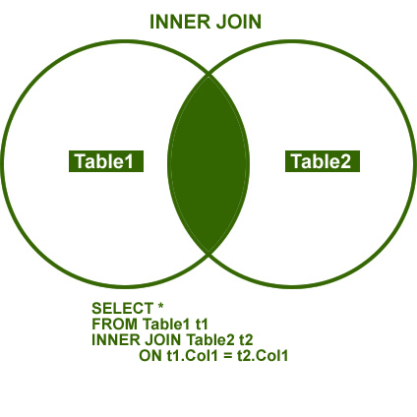
1.INNER JOIN
The INNER JOIN is formed when records from two tables are combined only if the rows from both the tables are matched based on a common column.
It represents the default join-type.

Slide 153
INNER JOIN
The keyword return rows when there is at least one match in both tables.
SQL INNER JOIN Syntax
SELECT column_name(s) FROM table_name1 INNER JOIN table_name2 ON table_name1.column_name=table_name2.column_name

Slide 154
The "Persons" table:
P_Id | LastName | FirstName | Address | City
1 | Hansn | Ola | Timoteivn 10 | Sandnes
2 | Svendson | Tove | Borgvn 23 | Sandnes
3 | Pettersen | Kari | Storgt 20 | Stavanger
O_Id | OrderNo | P_Id
1 | 77895 | 3
2 | 44678 | 3
3 | 22456 | 1
4 | 24562 | 1
5 | 34764 | 15
The "Orders" table:

Slide 155
SELECT Persons.LastName, Persons.FirstName, Orders.OrderNo FROM Persons INNER JOIN Orders ON Persons.P_Id=Orders.P_Id ORDER BY Persons.LastName
The result-set will look like this:
LastName | FirstName | OrderNo
Hansen | Ola | 22456
Hansen | Ola | 24562
Pettersen | Kari | 77895
Pettersen | Kari | 44678

Slide 156
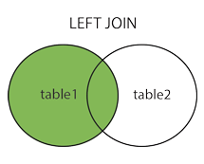
LEFT OUTER JOIN
The LEFT JOIN keyword returns all rows from the left table (table_name1), even if there are no matches in the right table (table_name2).
SQL LEFT JOIN Syntax
SELECT column_name(s) FROM table_name1 LEFT JOIN table_name2 ON table_name1.column_name=table_name2.column_name

Slide 157
The “Persons" table:
P_Id | LastName | FirstName | Address | City
1 | Hansen | Ola | Timoteivn 10 | Sandnes
2 | Svendson | Tove | Borgvn 23 | Sandnes
3 | Pettersen | Kari | Storgt 20 | Stavanger
The "Orders" table:
O_Id | OrderNo | P_Id
1 | 77895 | 3
2 | 44678 | 3
3 | 22456 | 1
4 | 24562 | 1
5 | 34764 | 15

Slide 158
Now we want to list all the persons and their orders - if any, from the tables above.
We use the following SELECT statement:
SELECT Persons.LastName, Persons.FirstName, Orders.OrderNo FROM Persons LEFT JOIN Orders ON Persons.P_Id=Orders.P_Id ORDER BY Persons.LastName
LastName | FirstName | OrderNo
Hansen | Ola | 22456
Hansen | Ola | 24562
Pettersen | Kari | 77895
Pettersen | Kari | 44678
Svendson | Tove
The result-set will look like this:

Slide 159
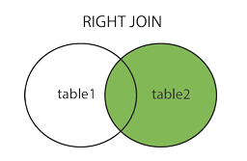
RIGHT OUTER JOIN
The RIGHT JOIN keyword returns all the rows from the right table (table_name2), even if there are no matches in the left table (table_name1).
SQL RIGHT JOIN Syntax
SELECT column_name(s) FROM table_name1 RIGHT JOIN table_name2 ON table_name1.column_name=table_name2.column_name

Slide 160
The “Persons" table
P_Id | LastName | FirstName | Address | City
1 | Hansen | Ola | Timoteivn 10 | Sandnes
2 | Svendson | Tove | Borgvn 23 | Sandnes
3 | Pettersen | Kari | Storgt 20 | Stavanger
The "Orders" table:
O_Id | OrderNo | P_Id
1 | 77895 | 3
2 | 44678 | 3
3 | 22456 | 1
4 | 24562 | 1
5 | 34764 | 15

Slide 161
We use the following SELECT statement:
SELECT Persons.LastName, Persons.FirstName, Orders.OrderNo FROM Persons RIGHT JOIN Orders ON Persons.P_Id=Orders.P_Id ORDER BY Persons.LastName
The result-set will look like this:
LastName | FirstName | OrderNo
Hansen | Ola | 22456
Hansen | Ola | 24562
Pettersen | Kari | 77895
Pettersen | Kari | 44678
 |  | 34764

Slide 162
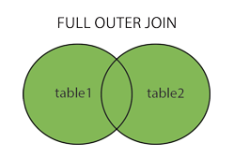
FULL JOIN
The FULL JOIN keyword return rows when there is a match in one of the tables.
SQL FULL JOIN Syntax
SELECT column_name(s) FROM table_name1 FULL JOIN table_name2 ON table_name1.column_name=table_name2.column_name

Slide 163
The “Persons" table
P_Id | LastName | FirstName | Address | City
1 | Hansen | Ola | Timoteivn 10 | Sandnes
2 | Svendson | Tove | Borgvn 23 | Sandnes
3 | Pettersen | Kari | Storgt 20 | Stavanger
The "Orders" table:
O_Id | OrderNo | P_Id
1 | 77895 | 3
2 | 44678 | 3
3 | 22456 | 1
4 | 24562 | 1
5 | 34764 | 15

Slide 164
SELECT Persons.LastName, Persons.FirstName, Orders.OrderNo FROM Persons FULL JOIN Orders ON Persons.P_Id=Orders.P_Id ORDER BY Persons.LastName
LastName | FirstName | OrderNo
Hansen | Ola | 22456
Hansen | Ola | 24562
Pettersen | Kari | 77895
Pettersen | Kari | 44678
Svendson | Tove
 |  | 34764
The result-set will look like this:

Slide 165
SELF JOIN
A SELF JOIN is used to find records in a table that are related to other records in the same table.
SQL SELF JOIN SYNTAX
SELECT column_name(s) FROM table_name1 SELF JOIN table_name2 ON table_name1.column_name=table_name2.column_name

Slide 166
TASK
Students Table having attributes as:
Name - Id
Location - Age
Duration - Contact
Aptech Table having attributes as:
Country -Branch Code
Location -Num_Batches
Courses - Date_of_Foundation

Slide 167
GROUP BY CLAUSE

Slide 168
The GROUP BY clause is used to organize output rows into groups.
Group by clause can be used with different clauses. That are given below
Group by with where
Group by with null
Group by with all
Group by with having

Slide 169
GROUP BY WITH WHERE
The where clause can be used with group by clause to restrict the row for grouping.
The rows that satisfy the search condition are considered fro grouping.
Example :
Select cust_id ,sum(salary) from customer where cust_name like ‘m%’ group by cust_id

Slide 170
GROUP BY WITH NULL
If the grouping column contain a null value, that row become a separate group in the result set.
Example:
select student_class,count(student_class) from student where student_class=‘null' group by student_class

Slide 171
GROUP BY WITH ALL
ALL is significant only when the SELECT has a WHERE clause. When ALL is used. It includes all the group by clause produces. It even includes those groups which do not meet the search conditions.
Example:
Select job,sum(salary) from emp where job like 's%' or job like 'c% 'group by all job

Slide 172
SUMMARIZING DATA
Group by clause also uses operator like
Cube
Rollup
Example:
Item | Color | quantity
Table | Blue | 124
Table | Red | 223
Chair | Blue | 101
Chair | Red | 210

Slide 173
Rollup
Generates the simple GROUP BY aggregate rows, plus subtotal or super-aggregate rows, and also a grand total row.
Example:
Select item_name,item_color,sum(item_quantity) from item group by item_name,item_color with rollup

Slide 174
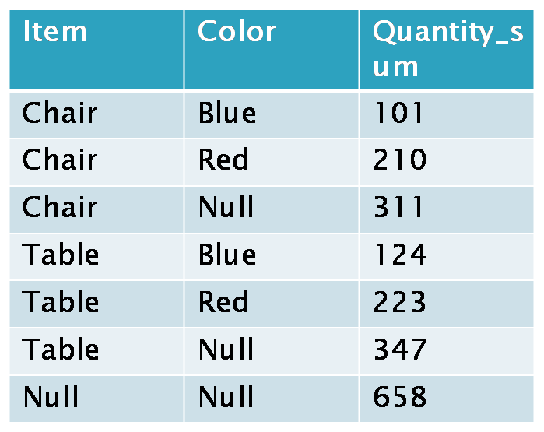
Output

Slide 175
CUBE
CUBE is an aggregate operator that produces a super aggregate row.
Example:
select item_name,item_color,sum(item_quantity) as total from item group by item_name,item_color with cube

Slide 176
Output
Item | Color | Quantity_sum
Chair | Blur | 101
Chair | Red | 210
Chair | Null | 311
Table | Blue | 124
Table | Red | 223
Table | Null | 347
Null | Null | 658
Null | Blue | 225
null | red | 433

Slide 177
Difference b/w CUBE & ROLLUP:
CUBE generates a result set that shows aggregates for all combinations of values in the selected columns.
ROLLUP generates a result set that shows aggregates for a hierarchy of values in the selected columns.

Slide 178
VIEWS

Slide 179
What is a VIEW?
A view is an "Virtual Table".
It can have multiple columns and rows from the one or more table.
Normally view cannot store the data permanently in the table.
Views display only those data which are mentioned in the query.
A view consists of a SELECT statement.
A view can have a maximum of 1024 columns.

Slide 180
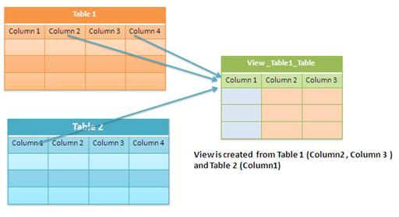

Slide 181
Use Of VIEWS
Views are used as Security Mechanism of Database.
A view can be useful when there are multiple users with different levels of access, who all need to see portions of the data in the database.
Views can do the following:
Restrict access to specific rows in a table
Restrict access to specific columns in a table
Join columns from multiple tables and present them as though they are part of a single table
Present aggregate information (such as the results of the COUNT function).

Slide 182

‘EmpInfo’ Table:

Slide 183
Creating a View
General syntax for creating a view:
CREATE VIEW [View_Name]
AS
[SELECT Statement]
As for example :
CREATE VIEW SampleView
As
SELECT EmpID, EmpName FROM EmpInfo

Slide 184

Running a View
This is as similar as select statement of a table.
SELECT * FROM SampleView

Slide 185
Drop a View
General syntax:
DROP VIEW viewname;
Example:
DROP VIEW SampleView;

Slide 186
When a view is dropped, it has no effect on the underlying tables.
Dropping a view removes its definition and all the permissions assigned to it.
However, dropping a table that references a view does not drop the view automatically.
You must drop it explicitly.

Slide 187
Alter a View
General syntax:
ALTER VIEW viewname
AS
SELECT…;
Example:
ALTER VIEW SampleView
AS
SELECT * FROM EmpInfo;

Slide 188
Display VIEW definition
There are 3 methods to see the view definition:
Method 1:
Sp_helptext viewname;
Method 2:
select definition from sys.sql_modules
where object_id=object_id(‘viewname');
Method 3:
select object_definition(object_id('vv'));

Slide 189
The sys.sql_modules is a system view. It is used to display view definition.
Object_definition() is built-in function that returns the view definition.
Object_id() is a system function that returns the ID of view.

Slide 190
TYPES OF VIEWS

Slide 191
TYPES OF VIEWS
There are two types of views in the sql server 2005.
Normal or Standard view
Partitioned view

Slide 192
1.Normal /Standard views
This view is most frequently used by the developers.
When we create the view the schema will be stored as object in the database.
When we retrieve the content from this virtual table, it will execute the schema and the stored data from the parent table.
These include focusing on specific data and simplifying data manipulation.

Slide 193
CREATE VIEW vw_empinfo AS SELECT * FROM EmpInfo;
SELECT * FROM vw_empinfo;
INSERT INTO vw_empinfo VALUES(4,’abcd’,’.NET’,565652);
DELETE FROM vw_empinfo WHERE EmpID = 1;
Here you can do the DML operations in the view when you have only one table.

Slide 194
2.Partitioned Views:
The partitioned view and its execution is like normal view.
It will work across the database and across the server.
There are two types of Partitioned views.
Local Partitioned View
Global Partitioned View

Slide 195
1. Local Partitioned View:
The local partitioned view can be created within same server but different database.
The view schema definition will be stored in the executed database.

Slide 196
USE Database1 CREATE TABLE EmployeeList ( iEmployeeID INT IDENTITY(1,1), vFirstName VARCHAR(25) NOT NULL, vLastName VARCHAR(25) NOT NULL, iDeptID INT )
USE Database2 CREATE TABLE Department ( iDeptID INT IDENTITY(1,1) PRIMARY KEY, vDeptName VARCHAR(50), )

Slide 197
CREATE VIEW vw_LocalPartion_View AS SELECT E.iEmployeeID, D.vDeptName FROM EmployeeList E
INNER JOIN
Database2.dbo.Department D ON D.iDeptID = E.iDeptID ;

Slide 198
2. Global Partitioned View
The global Partitioned view will work across the server.
The view can be created to join the table across the server.
The accessing format will be like this. [Server Name]. Database Name. Table Name
When we execute the view if it is not linked with the current server then it will ask us to link the external server.

Slide 199
The following system stored procedure will be used to link the server. sp_addlinkedserver 'Server name'
The following system catalog table is used to see the list of linked servers. SELECT * FROM SYS.SERVERS

Slide 200
View Creation Option
There are two different option for creating a view.
Schema Binding Option
Encryption

Slide 201
1-Schema BindSchema Binding Option:
If we Creates a view with the SCHEMABINDING option it will locks the tables being referred by the view and restrict any kinds of changes that may change the table schema ( No Alter Command) .
While creating schema binding view, we can't mention "Select * from tablename" with the query.
We have to mention all the column name for reference

Slide 202
CREATE VIEW DemoSampleView
With SCHEMABINDING
As
SELECT EmpID, EmpName, FROM DBO.EmpInfo;
While specifying the Database name we have use Dbo.[DbName] .
This will prevent any of the underlying tables from being altered without the view being dropped.

Slide 203
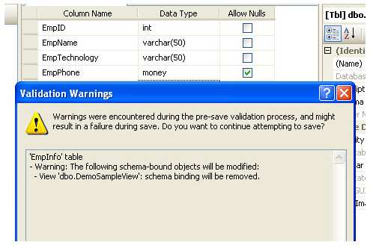
If we want to change/Alter the defination of a table which refered by a schema binded view, we will get following error message.

Slide 204
2-Encryption
This option encrypts the definition.
This option encrypts the definition of the view.
Users will not be able to see the definition of the View after it is created.
This is the main adavatages of view where we can make it secure.
Note: Once view is encrypted, there is no way to decrypt it again.
CREATE VIEW DemoView
With ENCRYPTION
Select ename,edesig from dbo.EmpInfo

Slide 205
DATA CONTROL LANGUAGE
DCL

Slide 206
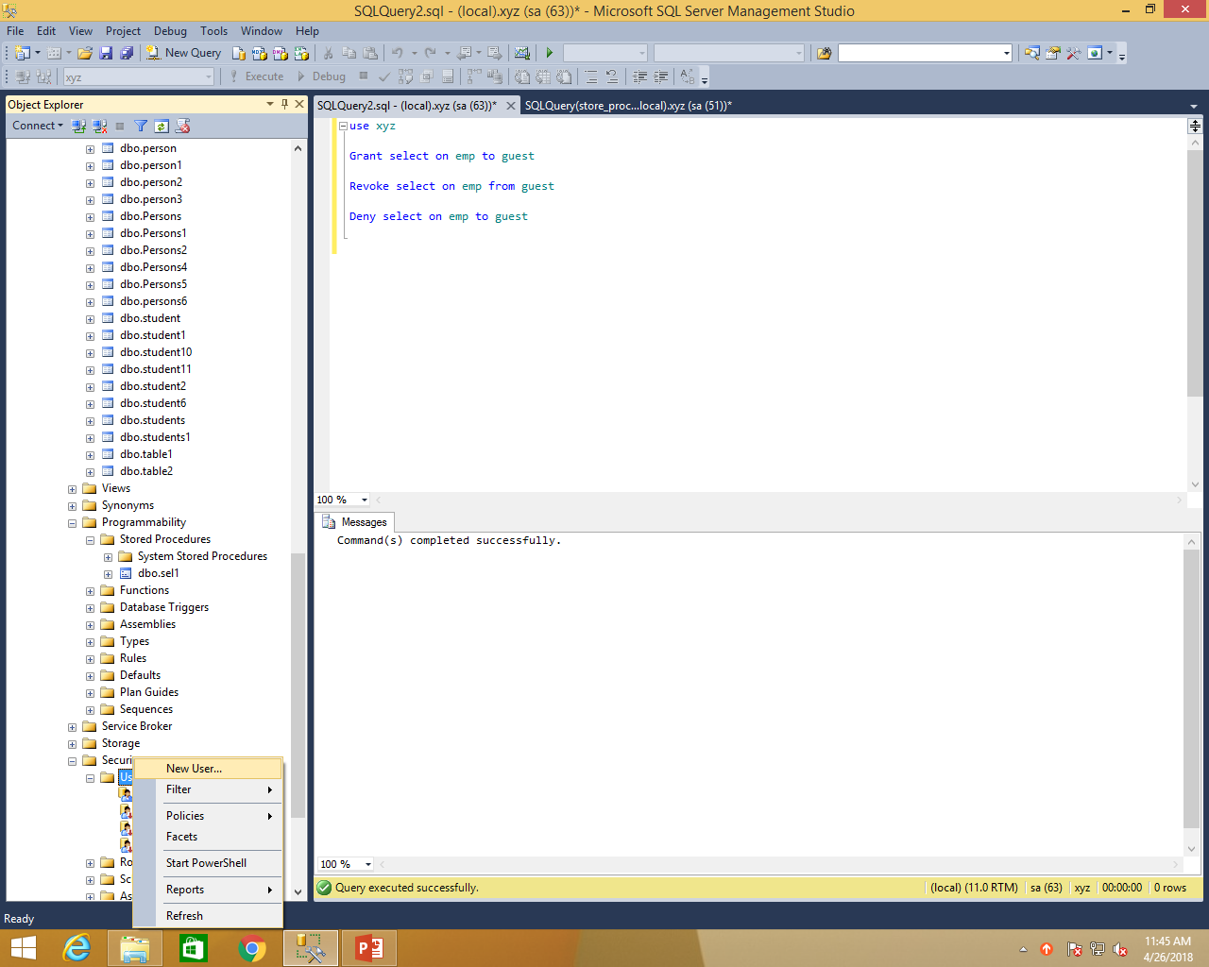

Slide 207
DCL is used to control permission on database objects.
DCL statements are used to take care of the security and authorization.
Types of DCL statements are as follows
Grant statement
Revoke statement
Deny statment

Slide 208
Grant statment
Grant privilege (rights which are to be allocated ) is used when database is to be shared with other users, with certain types of rights granted to the users.
Permissions are controlled by using the grant and revoke statements and deny statement.

Slide 209
Grant {all | statements}
On table_name
To security_account
Example:
Grant select on employee to john

Slide 210
Revoke statement
Revoke statement removes a previously granted or denied permission from a user in the current database

Slide 211
Revoke
{all | statement}
On table_name
From security_acccount
Example :
Revoke select on employee from john

Slide 212
Deny statement
The deny statemant creates an entry in the security system that denies a permission from a security account in the current database and prevents the security account from inheriting the permission through its group or role membership.

Slide 213
Deny {all | statement}
On table_name
To security_account
Example:
Deny select on employee to john

Slide 214
STORED PROCEDURES

Slide 215
CONTENTS
Introduction to stored procedures
Types of Stored Procedure
User defined stored procedures
Extended stored procedures
System stored procedures

Slide 216
INTRODUCTION TO STORED PROCEDURES
reuse the code over and over again.
query that you write over and over again, instead of having to write that query each time you would save it as a stored procedure
then just call the stored
In addition to running the same SQL code over and over again you also have the ability to pass parameters
so depending on what the need is the stored procedure can act accordingly based on the parameter values that were passed.

Slide 217
Types Of Stored Procedures
User Defined:
User defined stored procedures are also known as custom stored stored procedures.These procedures are used for reusing Transact-SQL statements for performing repetitive task.
Extended Stored procedures:
Extended stored procedures help SQL in interecting with operating system.These are carried out in DLL(Dynamic Link Library).It calls at the runtime.

Slide 218
System Stored Procedure
System stored procedure are commonly used for interacting with system tables.
They are prefixed with ‘sp_’
Catalog Stored Procedure
Database Stored Procedure
Database Engine Stored Procedure
Security Stored Procedure
Full-text Stored Procedure

Slide 219
Catalog stored procedure:
sp_tables //gives information about tables
exec sp_tables ‘%’,’dbo’,’students’ //students=databaseName
sp_stored_procedures //gives information about stored procedures
exec sp_stored_procedures ‘students’
//students=databaseName Or stored Procedure Name
sp_pkeys //gives information about primary keys
exec sp_pkeys ‘student_info’ //student_info = table Name

Slide 220
Database Engine Stored Procedures
Sp_who:
sp_who[[@login_name=] ‘login’
execute sp_who
Sp_help:
sp_help [ [@objectname= ] ‘name’]
execute sp_help ‘table_name’
Sp_recompile:
sp_recompile [@objectnm =] ‘storedproc_name’
sp_recompile ‘customer’

Slide 221
Security Stored procedures:
sp_addlogin
sp_addlogin [ @loginame = ] 'login'
[ , [ @passwd = ] 'password' ]
[ , [ @defdb = ] 'database' ]
[ , [ @deflanguage = ] 'language' ]
execute sp_addlogin ‘abc’,’123’,’1106E1’
exec sp_adduser ‘abc’
sp_droplogin
execute sp_droplogin ‘login_name’
exec sp_droplogin ‘abc’

Slide 222
Full-Text Stored procedures:
Sp_fulltext_catalog
exec sp_fulltext_catalog ‘ft_search’, ‘create’
Sp_fulltext_table
exec sp_fulltext_table ‘customer’,’create’,’ft_search’,’pk_CustId’
Sp_help_fulltext_tables
exec sp_help_fulltext_tables ‘ft_search’

Slide 223
USER DEFINED STORED PROCEDURE
Stored procedures are modules or routines that encapsulate code for reuse. A stored procedure can take input parameters, return tabular or scalar results and messages to the client, invoke data definition language (DDL) and data manipulation language (DML) statements, and return output parameters.

Slide 224
Create Stored Procedure
CREATE PROCEDURE GetStudentIdentification
AS
BEGIN
SELECT std_name, father_name,contact_number
FROM students_information
END
GO
Execute Stored Proceedure
exec GetStudentIdentification

Slide 225
The code inside the stored procedure can be something as simple as: SELECT * FROM USERLIST
Assume we have a table inventory
This information is updated in real-time and warehouse managers are constantly checking the levels of products stored at their warehouse and available for shipment. In the past, each manager would run queries similar to the following:
SELECT Product, Quantity FROM Inventory WHERE Warehouse = 'FL'

Slide 226
We can simplify this process through the use of a stored procedure
CREATE PROCEDURE sp_GetInventory @location varchar(10) AS SELECT Product, Quantity FROM Inventory WHERE Warehouse = @location

Slide 227
Our Florida warehouse manager can then access inventory levels by issuing the command
EXECUTE sp_GetInventory 'FL‘
The New York warehouse manager can use the same stored procedure to access that area's inventory.
EXECUTE sp_GetInventory 'NY'

Slide 228

Using Wildcard Characters:
Create procedure wild_cards
@name varchar(20)
as
Select * from employee where emp_name like @name
execute wild_cards 'D%'

Slide 229
Input Variables
There are many reasons for wanting to pass data to a stored procedure, especially if your stored procedure is being called by a dynamic web page or other application.
You may want to use a SELECT statement to pull information into the application for dynamic display. In this case, you would pass selection criteria to the stored procedure (for use in a WHERE clause).
If you are inserting new records, you will need to get the data from somewhere. Updating existing records also involves simply getting the data. In both INSERT and UPDATE statements, it is necessary to pass data to the stored procedure. For INSERT, UPDATE, and SELECT statements (to name a few), you can pass the data to your stored procedure using variables.

Slide 230
CREATE PROCEDURE usp_adduser
@login varchar(20), @pswd varchar(20), @f_name varchar(25), @l_name varchar(35), @address_1 varchar(30), @address_2 varchar(30), @city varchar(30), @state char(2), @zipcode char(10), @email varchar(50)
AS INSERT INTO USERLIST (login, pswd, f_name, l_name, address_1, address_2, city, state, zipcode, email) VALUES (@login, @pswd, @f_name, @l_name, @address_1, @address_2, @city, @state, @zipcode, @email)

Slide 231
exec usp_adduser ‘dnelson’, ‘dean2003′, ‘Dean’, ‘Nelson’, ’200 Berkeley Street’, ‘ ‘, ‘Boston’, ‘MA’, ’02116′, ‘dnelson@test.com’

Slide 232
CREATE PROCEDURE usp_updateuser
@usr_id int, @login varchar(20), @pswd varchar(20), @f_name varchar(25), @l_name varchar(35), @address_1 varchar(30), @address_2 varchar(30), @city varchar(30), @state char(2), @zipcode char(10), @email varchar(50)
AS UPDATE USERLIST
SET
login=@login, pswd=@pswd, f_name=@f_name, l_name=@l_name, address_1=@address_1, address_2=@address_2, city=@city, state=@state, zipcode=@zipcode, email=@email
WHERE usr_id=@usr_id

Slide 233
CREATE PROCEDURE usp_finduser
@usr_id int
AS
SELECT * FROM USERLIST WHERE usr_id=@usr_id
Execute Statement:
exec usp_finduser ’1′

Slide 234
If – else statement
create procedure insert_details
@emp_id bigint,
@emp_nm varchar(50),
@emp_age bigint,
@emp_sal bigint,
@mgr_id bigint
as
if @emp_id is null
begin
print 'hello'
return
end
else
begin
insert into emp_copy values(@emp_id,@emp_nm,@emp_age,@emp_sal,@mgr_id)
end

Slide 235
TRY…….CATCH Construct
Each try catch construct must be inside a stored procedure.
A TRY block must be immediately followed by a CATCH block.
To handle an error that occurs within a given CATCH block, write a TRY…CATCH block within the specified CATCH block.
Errors that have the 10 or below severity level are not handled by try…catch blocks. These errors are considered as warning or informational messages.
Errors that have severity of 20 or higher are not handled by try…catch blocks. Database engine close the connection will not be handled by the try..catch block.

Slide 236
ERROR Function
Error_line()
Error_number()
Error_message()
Error_procedure()
Error_severity()
Error_state()

Slide 237
EXAMPLE
Create procedure delete_employee
@empid bigint
As
Set @empid=‘E001’
Delete from employee where emp_id=@empid
Begin try
Execute delete_employee
End try
Begin catch
Select error_procedure() as ErrorProcedure
End catch

Slide 238
Sp_addmessage stored procedure
Execute sp_addmessage @msgnum=50001, @severity=10,
@msgtext=‘This is a customized error’,
@lang=‘us_english’
Raiserror(50001,10,1)

Slide 239
SUBQUERY

Slide 240



Using a Subquery to Solve a Problem
Who has a salary greater than Abel’s?
Main query:
Which employees have salaries greater than Abel’s salary?
Subquery:
What is Abel’s salary?
Notes:
Using a Subquery to Solve a Problem
Suppose you want to write a query to find out who earns a salary greater than Abel’s salary.
To solve this problem, you need two queries: one to find how much Abel earns, and a second query to find who earns more than that amount.
You can solve this problem by combining the two queries, placing one query inside the other query.
The inner query (or subquery) returns a value that is used by the outer query (or main query). Using a subquery is equivalent to performing two sequential queries and using the result of the first query as the search value in the second query.

Slide 241
The basic concept is to pass a single value or many
values from the subquery to the next query and so on.
4
3
2
1
When reading or writing SQL subqueries, you should start from the bottom upwards, working out which data is to be passed to the next query up.

Slide 242
Comparators
= equal to
> greater than
>= greater than or equal to
< less than
<= less than or equal to
<> not equal to
and other keywords ……
IN
NOT IN
ANY
ALL

Slide 243
Subquery Syntax
SELECT select_list
FROM table
WHERE expr operator
(SELECT select_list
FROM table);
The subquery (inner query) executes before the main query (outer query).
The result of the subquery is used by the main query.
Notes:
Subquery Syntax
A subquery is a SELECT statement that is embedded in the clause of another SELECT statement. You can build powerful statements out of simple ones by using subqueries. They can be very useful when you need to select rows from a table with a condition that depends on the data in the table itself.
You can place the subquery in a number of SQL clauses, including the following:
WHERE clause
HAVING clause
FROM clause
In the syntax:
operator includes a comparison condition such as >, =, or IN
Note: Comparison conditions fall into two classes: single-row operators (>, =, >=, <, <>, <=) and multiple-row operators (IN, ANY, ALL).
The subquery is often referred to as a nested SELECT, sub-SELECT, or inner SELECT statement. The subquery generally executes first, and its output is used to complete the query condition for the main (or outer) query.

Slide 244
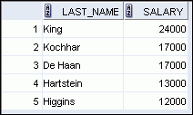
Using a Subquery
SELECT last_name, salary
FROM employees
WHERE salary >
(SELECT salary
FROM employees
WHERE last_name = 'Abel');
11000
Notes:
Using a Subquery
In the slide, the inner query determines the salary of employee Abel. The outer query takes the result of the inner query and uses this result to display all the employees who earn more than employee Abel.

Slide 245
Types of Subqueries
Single-row subquery
Multiple-row subquery
Main query
Subquery
returns
ST_CLERK
Main query
returns
ST_CLERK
SA_MAN
Subquery
Notes:
Types of Subqueries
Single-row subqueries: Queries that return only one row from the inner SELECT statement
Multiple-row subqueries: Queries that return more than one row from the inner SELECT statement
Note: There are also multiple-column subqueries, which are queries that return more than one column from the inner SELECT statement. These are covered in the Oracle Database 11g: SQL Fundamentals II course.

Slide 246

Executing Single-Row Subqueries
SELECT last_name, job_id, salary
FROM employees
WHERE job_id =
(SELECT job_id
FROM employees
WHERE last_name=‘Taylor’)
AND salary >
(SELECT salary
FROM employees
WHERE last_name=‘Taylor’);
SA_REP
8600
Notes:
Executing Single-Row Subqueries
A SELECT statement can be considered as a query block. The example in the slide displays employees who do the same job as “Taylor,” but earn more salary than him.
The example consists of three query blocks: the outer query and two inner queries. The inner query blocks are executed first, producing the query results SA_REP and 8600, respectively. The outer query block is then processed and uses the values that were returned by the inner queries to complete its search conditions.
Both inner queries return single values (SA_REP and 8600, respectively), so this SQL statement is called a single-row subquery.
Note: The outer and inner queries can get data from different tables.

Slide 247
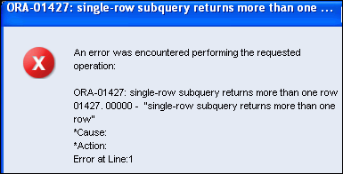
What Is Wrong with This Statement?
SELECT employee_id, last_name
FROM employees
WHERE salary =
(SELECT MIN(salary)
FROM employees
GROUP BY department_id);
Single-row operator with multiple-row subquery
Notes:
What Is Wrong with This Statement?
A common error with subqueries occurs when more than one row is returned for a single-row subquery.
In the SQL statement in the slide, the subquery contains a GROUP BY clause, which implies that the subquery will return multiple rows, one for each group that it finds. In this case, the results of the subquery are 4400, 6000, 2500, 4200, 7000, 17000, and 8300.
The outer query takes those results and uses them in its WHERE clause. The WHERE clause contains an equal (=) operator, a single-row comparison operator that expects only one value. The = operator cannot accept more than one value from the subquery and, therefore, generates the error.
To correct this error, change the = operator to IN.

Slide 248
Multiple-Row Subqueries
Return more than one row
Use multiple-row comparison operators
Operator
Meaning
IN
Equal to any member in the list
ANY
Must be preceded by =, !=, >, <, <=, >=. Compares a value to each value in a list or returned by a query. Evaluates to FALSE if the query returns no rows.
ALL
Must be preceded by =, !=, >, <, <=, >=. Compares a value to every value in a list or returned by a query. Evaluates to TRUE if the query returns no rows.
Notes:
Multiple-Row Subqueries
Subqueries that return more than one row are called multiple-row subqueries. You use a multiple-row operator, instead of a single-row operator, with a multiple-row subquery. The multiple-row operator expects one or more values:
SELECT last_name, salary, department_id
FROM employees
WHERE salary IN (SELECT MIN(salary)
FROM employees
GROUP BY department_id);
Example:
Find the employees who earn the same salary as the minimum salary for each department.
The inner query is executed first, producing a query result. The main query block is then processed and uses the values that were returned by the inner query to complete its search condition. In fact, the main query appears to the Oracle server as follows:
SELECT last_name, salary, department_id
FROM employees
WHERE salary IN (2500, 4200, 4400, 6000, 7000, 8300, 8600, 17000);

Slide 249
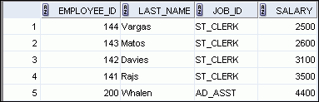

Using the ANY Operator in Multiple-Row Subqueries
SELECT employee_id, last_name, job_id, salary
FROM employees
WHERE salary < ANY
(SELECT salary
FROM employees
WHERE job_id = 'IT_PROG')
AND job_id <> 'IT_PROG';
9000, 6000, 4200
…
Notes:
Using the ANY Operator in Multiple-Row Subqueries
The ANY operator (and its synonym, the SOME operator) compares a value to each value returned by a subquery. The slide example displays employees who are not IT programmers and whose salary is less than that of any IT programmer. The maximum salary that a programmer earns is $9,000.
<ANY means less than the maximum. >ANY means more than the minimum. =ANY is equivalent to IN.

Slide 250
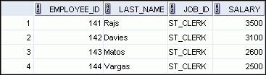
Using the ALL Operator in Multiple-Row Subqueries
SELECT employee_id, last_name, job_id, salary
FROM employees
WHERE salary < ALL
(SELECT salary
FROM employees
WHERE job_id = 'IT_PROG')
AND job_id <> 'IT_PROG';
9000, 6000, 4200
Notes:
Using the ALL Operator in Multiple-Row Subqueries
The ALL operator compares a value to every value returned by a subquery. The example in the slide displays employees whose salary is less than the salary of all employees with a job ID of IT_PROG and whose job is not IT_PROG.
>ALL means more than the maximum and <ALL means less than the minimum.
The NOT operator can be used with IN, ANY, and ALL operators.

Slide 251
Indexes

Slide 252
This session will cover…..
What are indexes and why they are used?
Indexes may be either Clustered or Non-Clustered.
Types of indexes
How to create indexes

Slide 253
What are indexes and why they are used?
Every organization has its database and each and every day with the increase in the data volume these organizations has to deal with the problems relating to data retrieval and accessing of data.
There is need of system which will results into increase in the data access speed.
An index (in simple words it like index of any book eg. While searching a word in Book we use index back of book to find the occurrence of that word and its relevant page numbers), which makes it easier for us to retrieval and presentation of the data.

Slide 254
An Index is a system which provides faster access to rows and for enforcing constraints.
If we don't create any indexes then the SQL engine searches every row in table (also called as table scan). As the table data grows to thousand, millions of rows and further then searching without indexing becomes much slower and becomes expensive.

Slide 255
Indexes may be either Clustered or Non-Clustered.
A clustered index stores data rows in the table based on their key values. Each table can have only one clustered index as the key values in the data rows are unique and the index is built on the unique key column. When a table has a clustered index, it is known as a clustered table.
A table can have only one clustered index.

Slide 256
PRIMARY KEY constraints create clustered indexes automatically if no clustered index already exists on the table.
A clustered index rearranges the data in a sequential manner.
Example:
Telephone directory

Slide 257
Non-Clustered indexes have structures that are different from the data rows. A non clustered index key value is used to point to data rows that contain the key value. This value is known as row locator.
.

Slide 258
Typically created on non-primary key columns used in JOIN, WHERE, and ORDER BY clause.

Slide 259
Types of Indexes
In SQL Server, indexes are created on
tables to increase the speed of data retrieval.
UNIQUE INDEX
Clustered INDEX
Non Clustered Index

Slide 260
UNIQUE INDEX:
A unique index does not allow any duplicate values in the index field of a table.
It ensures that every row in the table is unique.
While designing a unique index, consider the following guidelines:
A unique index cannot be created if duplicate key values exists in the table.
Non-key columns can be included in a unique non-clustered index.
Syntax:
Create unique clustered index indexName
On tableName (columnName)

Slide 261
note that unique indexes cannot be created on a single column if the column contains NULL in more than one row. Similarly indexes cannot be created on multiple columns if the combination of the columns contains NULL in some rows. The NULL values are treated as duplicate values.

Slide 262
Clustered Index
Clustered indexes can be created in SQL Server databases. In such cases the logical order of the index key values will be the same as the physical order of rows in the table. A table can have only one clustered index, but a clustered index has more than one column.
CREATE Clustered INDEX <index_name> ON <table_name>(column)
CREATE CLUSTERED INDEX CIX_EmpDetails_EmpId ON dbo.EmployeeDetails(EmployeeID)
Two columns clustered index:
CREATE CLUSTERED INDEX CIX_EmpDetails_EmpId ON dbo.EmployeeDetails(EmployeeID ASC, PassportNumber DESC)

Slide 263
Indexes can be deleted. Usually an index is considered for deletion when the performance of the INSERT,UPDATE and DELETE operations are hindered by the Index.
DROP index tableName.indexName;

Slide 264
Triggers:
Triggers in SQL Server 2012 are a special kind of stored procedure that fires automatically; they are invoked or executed when an event occurs in the database server.
We can create Data Manipulation Language (DML) triggers and Data Definition Language (DDL) triggers in SQL Server 2012.
When the user wants to modify data using a DML event then the DML trigger is executed. In other words, a DML trigger is used for INSERT, DELETE and UPDATE statements of a table or view.
When the user attempts to perform an operation using DDL then the DDL trigger is executed. In other words, a DDL trigger is executed for CREATE, ALTER and DROP statements of a table or view.
There are two types of triggers AFTER TRIGGER and INSTEAD OF TRIGGER

Slide 265
Triggers:
DML Triggers in SQL Server:
DML triggers in SQL Server are fired when a DML event occurs. i.e. when data is inserted/ updated/deleted in the table by a user.
Syntax:
CREATE TRIGGER TR_UPD_Locations ON Customer
FOR INSERT
AS
BEGIN
INSERT INTO ExistingTable
SELECT costomerID
,getdate()
FROM inserted
END

Slide 266
Triggers:
Basic insert trigger:
create trigger tr_insert_employee
on Employees
after insert
as
begin
print 'value inserted in the table employees'
select * from inserted
End
Delete Trigger:
create trigger tr_del_empl
on employees
after delete
as
begin
print 'somethig deleted from the employees table'
end
delete from employees where EmployeeID = 10;

Slide 267
Triggers:
Audit Table for Trigger:
create trigger tr_audit_info
on employees
after insert, delete
as
declare @id int, @name varchar(255)
begin
select @id = EmployeeID, @name = FirstName from inserted
insert into audit_empoyees_table values ('student with id ' + cast(@id as varchar(50)) + 'and name ' + cast(@name as varchar(100)) + ' is inserted at ' + cast(GETDATE() as varchar(50)))
End

Slide 268
Triggers:
Update Trigger:
create trigger tr_update_empl
on employees
after update
as
begin
select * from inserted
select * from deleted
End
Instead of Triggers:
create trigger tr_instead_insert
on employees instead of insert
as
begin
print 'data inserted in the table employees'
end

Slide 269
Triggers:
Instead of Trigger:
create trigger instead_delete on employees
instead of delete
as
begin
select * from deleted
end
select * from employees
delete from employees where EmployeeID = 1

Slide 270
Triggers:
Instead of triggers in SQL Server:
These triggers are fired before the DML event and the actual data is not modified in the table.
For example, if we specify an instead of trigger for delete on a table, when delete statement is issued against the table, the instead of trigger is fired and the T-SQL block inside the triggers in SQL Server is executed but the actual delete does not happen.
Syntax:
CREATE TRIGGER TR_DEL_Locations ON Locations
INSTEAD OF DELETE
AS
BEGIN
Select 'Sample Instead of trigger' as [Message]
END

Slide 271
Triggers:
DDL Triggers:
DDL triggers in SQL Server are fired on DDL events. i.e. against create, alter and drop statements, etc. These triggers are created at the database level or server level based on the type of DDL event.
These triggers are useful in the below cases.
Prevent changes to the database schema
Audit database schema changes
To respond to a change in the database schema
Syntax for creating DDL trigger on DataBase:
CREATE TRIGGER TR_ALTERTABLE ON DATABASE
FOR CREATE_TABLE
AS
BEGIN
INSERT INTO TableSchemaChanges
Print ‘someone trying to create a table’
END
Drop trigger Trigger_Name on Database

Slide 272
Triggers:
Syntax for creating trigger on server:
Create trigger Tr_on_server on All server
For Create_Table
As
Begin
Print ‘someone trying to create the table’
end

